Slide 1
Module 1: SQL Server Integration Services Introduction (SSIS)

Slide 3
Agenda
What is SQL Server Integration Services (SSIS)?
SSIS Architecture
SSIS Components
SSIS High Availability
New to SSIS 2016, SSIS 2017, and SSIS 2019.
SSIS Usage Scenario

Slide 4
What is SQL Server Integration Services (SSIS)?
SQL Server Integration Services (SSIS) provides a platform for Extract, Transform, and Load (ETL) functionality for Enterprise data.
Introduced in SQL Server 2005.
Successor of Data Transformation Services (DTS) (SQL Server 2000 or older).

Slide 5
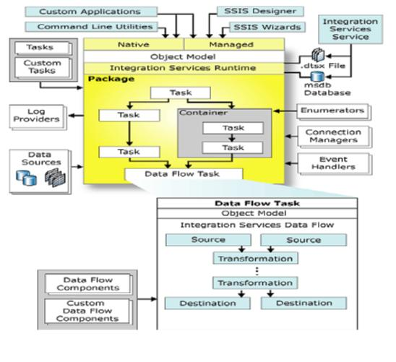
SSIS Architecture
SSIS CatalogDB
Notes:
Talking Points
Overview, don't go deep into each component – we will talk about it in next slides.

Slide 6
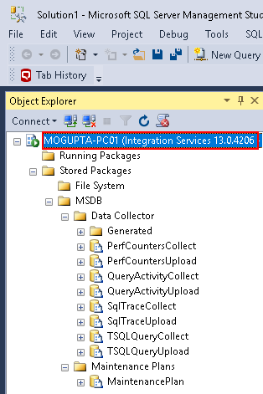
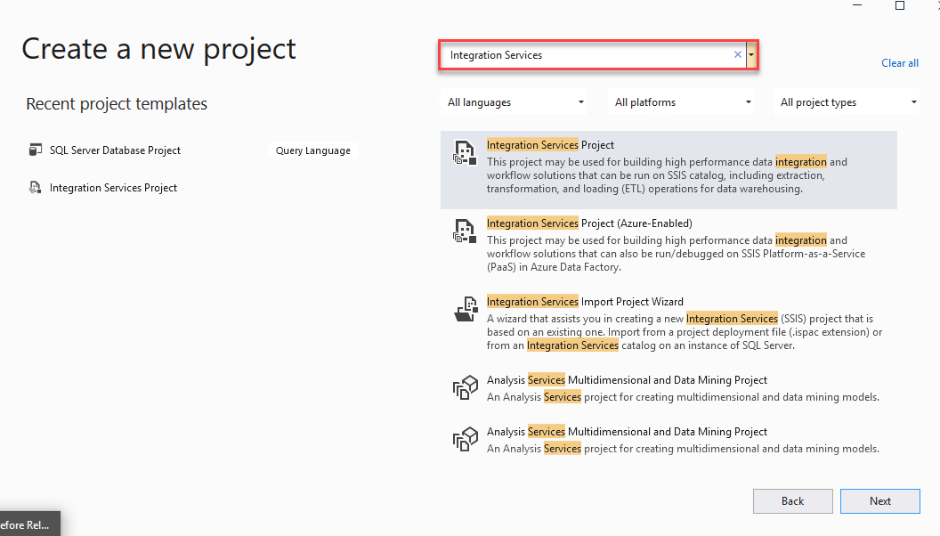
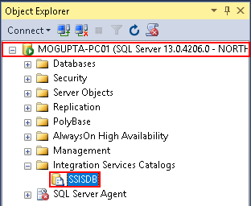
SSIS Components
Development & Management Tools
SQL Server Management Studio (SSMS)
SQL Server Data Tools (SSDT) Add-On for Visual Studio
Notes:
Talking Points:
SSIS management tools via SSMS.
SSIS development tools via Visual Studio.

Slide 7
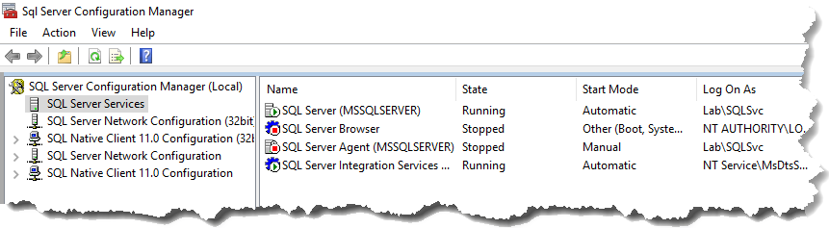
SSIS Components
SSIS Service
Extends the management capabilities of SSMS.
Generally installed on SQL Server instance.
Visible in SQL Server Configuration manager or SSMS.
Required for SQL Server SSIS DB Catalog.
Import/Export SSIS Packages.
Manually Execute/Stop SSIS Packages.
Provides ability to monitor executions.
Notes:
https://support.microsoft.com/en-us/help/942176/description-of-the-sql-server-integration-services-ssis-service-and-of

Slide 8
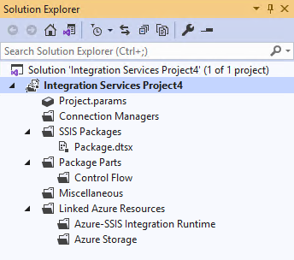
SSIS Components
Project & Packages
Projects allow the ability group packages and objects with similar workload together.
Projects can contain packages, connection manager (shared connections), parameters, etc.
Tip: If solution explorer is not visible, you can launch via View Menu > Solution Explore or keyboard shortcut CTRL + W, S

Slide 9
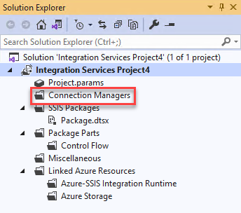
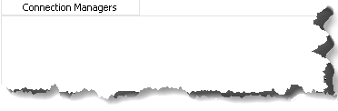
SSIS Components
Connection Managers
Provide ability to collect to data sources for both source and destination.
Ability to create connections both at project level and package level.

Slide 10
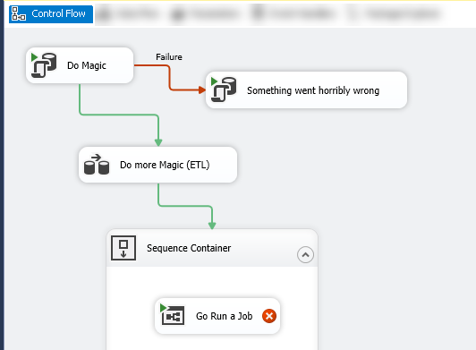
SSIS Components
Control Flow
Tasks
Constraints
Containers
Notes:
Talking Points: * Everything in SSIS is a task. A task can do something on system, database, or call other packages.

Slide 11
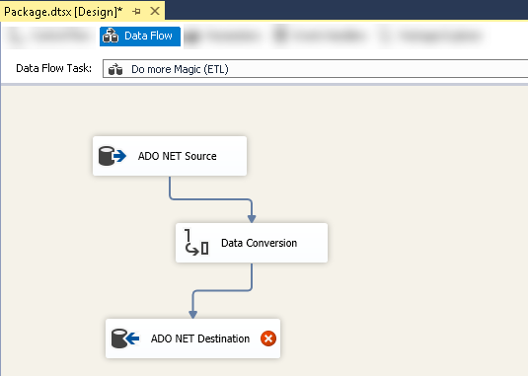
SSIS Components
Data Flow
Extract
Transform
Load

Slide 12
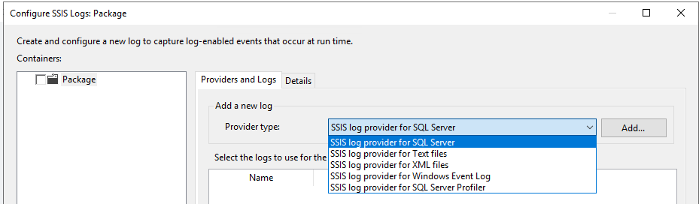
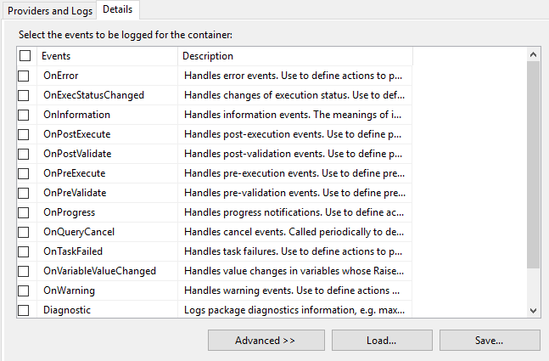
SSIS Components
Log Providers
Define destination for logging execution log details.
Information can be logged to:
Text File
SQL Profiler
SQL Server
Windows Event Logs
XML Files
We can choose which events & details to log.
Notes:
Integration Services (SSIS) Logging - SQL Server Integration Services (SSIS) | Microsoft Docs

Slide 13
SSIS Components
Enumerators
Allows you to loop through a list of objects.
Enumerator | Configuration requirements
Foreach ADO | Specify the ADO object source variable and the enumerator mode. The variable must be of Object data type.
Foreach ADO.NET Schema Rowset | Specify the connection to a database and the schema to enumerate.
Foreach File | Specify a folder and the files to enumerate, the format of the file name of the retrieved files, and whether to traverse subfolders.
Foreach From Variable | Specify the variable that contains the objects to enumerate.
Foreach Item | Define the items in the Foreach Item collection, including columns and column data types.
Foreach Nodelist | Specify the source of the XML document and configure the XPath operation.
Foreach SMO | Specify the connection to a database and the SMO objects to enumerate.
Foreach HDFS File Enumerator | Specify a folder and the files to enumerate, the format of the file name of the retrieved files, and whether to traverse subfolders.
Foreach Azure Blob | Specify the Azure blob container that containers blobs to be enumerated.
Foreach ADLS File | Specify the Azure Data Lake Store directory that contains the files to be enumerated.
Foreach Data Lake Storage Gen2 File | Specify the Azure Data Lake Storage Gen2 directory that contains the files to be enumerated, along with other options.
Notes:
Foreach Loop Container - SQL Server Integration Services (SSIS) | Microsoft Docs

Slide 14
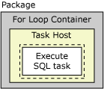
SSIS Components
Event Handlers
Triggers at various stages of package execution.
Can be used to …
Clean up temporary data storages when package or task finishes running.
Retrieve system information to assess resource availability before a package runs.
Refresh data in a table when a lookup in a reference table fails.
Send an e-mail message when an error or a warning occurs or when a task fails.
Event handler | Event
OnError | The event handler for the OnError event. This event is raised by an executable when an error occurs.
OnExecStatusChanged | The event handler for the OnExecStatusChanged event. This event is raised by an executable when its execution status changes.
OnInformation | The event handler for the OnInformation event. This event is raised during the validation and execution of an executable to report information. This event conveys information only, no errors or warnings.
OnPostExecute | The event handler for the OnPostExecute event. This event is raised by an executable immediately after it has finished running.
OnPostValidate | The event handler for the OnPostValidate event. This event is raised by an executable when its validation is finished.
OnPreExecute | The event handler for the OnPreExecute event. This event is raised by an executable immediately before it runs.
OnPreValidate | The event handler for the OnPreValidate event. This event is raised by an executable when its validation starts.
OnProgress | The event handler for the OnProgress event. This event is raised by an executable when measurable progress is made by the executable.
OnQueryCancel | The event handler for the OnQueryCancel event. This event is raised by an executable to determine whether it should stop running.
OnTaskFailed | The event handler for the OnTaskFailed event. This event is raised by a task when it fails.
OnVariableValueChanged | The event handler for the OnVariableValueChanged event. This event is raised by an executable when the value of a variable changes. The event is raised by the executable on which the variable is defined. This event is not raised if you set the RaiseChangeEvent property for the variable to False. For more information, see Integration Services (SSIS) Variables.
OnWarning | The event handler for the OnWarning event. This event is raised by an executable when a warning occurs.
Notes:
Integration Services (SSIS) Event Handlers - SQL Server Integration Services (SSIS) | Microsoft Docs

Slide 15
SSIS Components
SSIS CatalogDB
Objects stored here are projects, packages, parameters, environments, and operational history.
Notes:
https://docs.microsoft.com/en-us/sql/integration-services/catalog/ssis-catalog?view=sql-server-2017

Slide 16
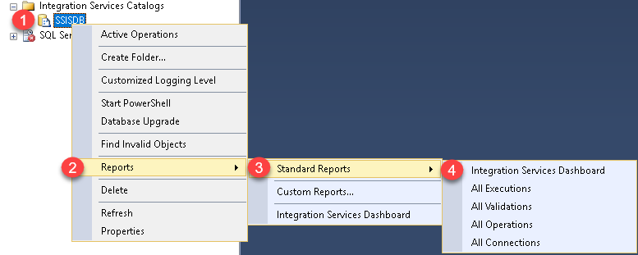
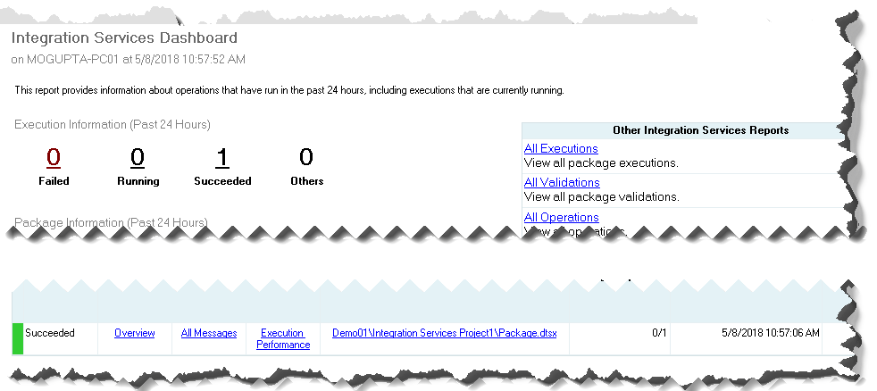
SSIS Components
SSIS Reports
Provide execution history of all the packages in SSIS Catalog DB.

Slide 17
SSIS Catalog DB
Demo
Notes:
Demo: Module 01: Creating SSIS Catalog DB

Slide 18
SSIS High Availability
Leverage SQL Server AlwaysOn Availability Groups
SSIS Service itself is not highly available, instead we leverage SSIS CatalogDB via AG to provide HA.
Notes:
Integration Services (SSIS) in a Cluster - SQL Server Integration Services (SSIS) | Microsoft Docs
SSIS with AlwaysOn - Microsoft Tech Community
SSIS AlwaysOn Availability Groups – SQL Skills

Slide 19
New to SSIS 2016
Manageability
AlwaysOn Support for SSIS Catalog
Incremental Package Deployment
Support for Always Encrypted for SSIS Catalog
Debugging
New security roles.
New logging levels/server wide settings.
Better Package Management
Project Upgrade
Reusable Control Flow Templates
Connectivity
Expanded connector for Odata, Hadoop, SAP BW, Azure Cloud, etc.
Notes:
https://docs.microsoft.com/en-us/sql/integration-services/what-s-new-in-integration-services-in-sql-server-2016?view=sql-server-2017

Slide 20
New to SSIS 2017
Scale Out
Integration Services on Linux
Connectivity Improvements
Notes:
Scale Out. Distribute SSIS package execution more easily across multiple worker computers, and manage executions and workers from a single master computer. For more info, see Integration Services Scale Out.
Integration Services on Linux. Run SSIS packages on Linux computers. For more info, see Extract, transform, and load data on Linux with SSIS.
Connectivity improvements. Connect to the OData feeds of Microsoft Dynamics AX Online and Microsoft Dynamics CRM Online with the updated OData components.
What's New in Integration Services in SQL Server 2017 - SQL Server Integration Services (SSIS) | Microsoft Docs

Slide 21
New to SSIS 2019
New Features to Improve File Operations
Flexible File Task
Flexible File Source and Destination
Notes:
Flexible file task: Perform file operations on Local File System, Azure Blob Storage, and Azure Data Lake Storage Gen2. See Flexible File Task.
Flexible file source and destination: Read and write data for Azure Blob Storage, and Azure Data Lake Storage Gen2. See Flexible File Source and Flexible File Destination.
What's new in SQL Server 2019 - SQL Server | Microsoft Docs

Slide 22
SSIS Usage Scenario
Archival of Data (Export)
Loading of New Data (Import)
Transferring data from one data source to another
Data cleansing or Transformation of Dirty Data
DBA Tasks like Purging old files or indexing a database

Slide 23
SSIS Catalog DB
Lab

Slide 24
Questions?
What are some of the components of SSIS?
SSIS Catalog DB, Control Flow, Data Flow, etc.
Which phase of the ETL is usually the most expensive?
Transport is the most expensive phase, in most ETL processes.
Can we create multiple SSIS Catalog DB per instance?
No limited to one SSIS catalog database per instance.
What high availability option do we recommend for SSIS?
AlwaysOn Availability Groups

